Slide 2
1/5 of all food
goes to waste.
$11 BILLION LOST ANNUALLY
Overproduction, unpredictable demand, and wasteful consumer behavior
5 MILLION
TONS PER YEAR
Notes:
In the United States 133 billion pounds of food is wasted each year.
That’s 38% percent of the food supply...over $160 billion dollars worth.
Food is the single largest category of material placed in municipal landfills.
And that rotting food contributes to more than 8 percent of global greenhouse gas emissions.

Slide 3
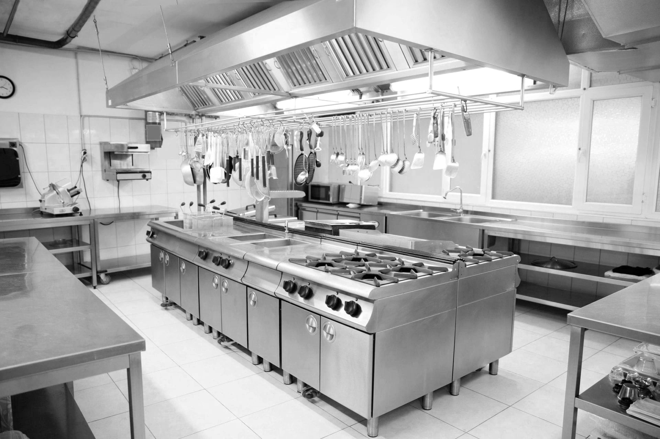
Kitchen Waste
Plate Waste
Back-end Production Waste
Overproduction, Preparation Errors
33% of waste in large scale dining facilities
Front-end Consumer Plate Waste
Over plating, poor food taste, limited eating time
66% of waste in large scale dining facilities
VS

Slide 4
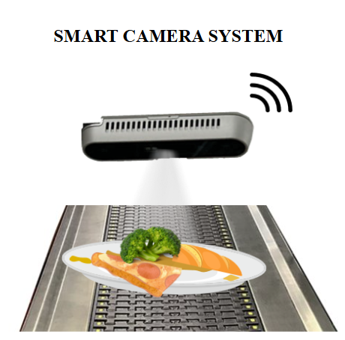
CPIsight Alpha
Real Time Actionable Analytics
Intervention
Responsiveness
Taste Control
Aggregate Data
Spotting Consumer Trends
Itemized by specific foods
Menu preference alignment
Demand Planning
Automated CSR Reporting
Eliminates manual auditing and associated costs
Faster CSR results
"Continual Food Audit"
Cost for Hardware: ~ $700

Slide 5
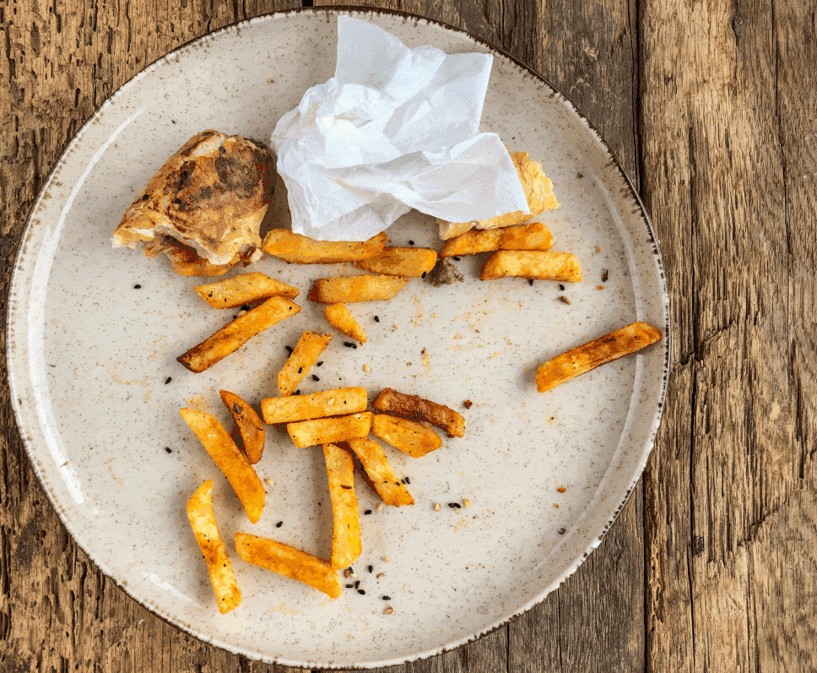
CPIsight Alpha
Proprietary System Food Identification
Notes:
That’s why I created Clean Plate...I’m commercializing a scalable solution that leverages computer vision and AI to attack the systemic issue of food waste by looking directly at the issue...THE PLATE WASTE.
Clean Plate exists to transform kitchen operations through intelligent food waste tracking.
Our mission is to provide data-driven visibility that empowers dining providers to dramatically reduce waste and cost.
We aim to optimize production planning and unlock savings while better aligning with CONSUMER preferences.

Slide 7
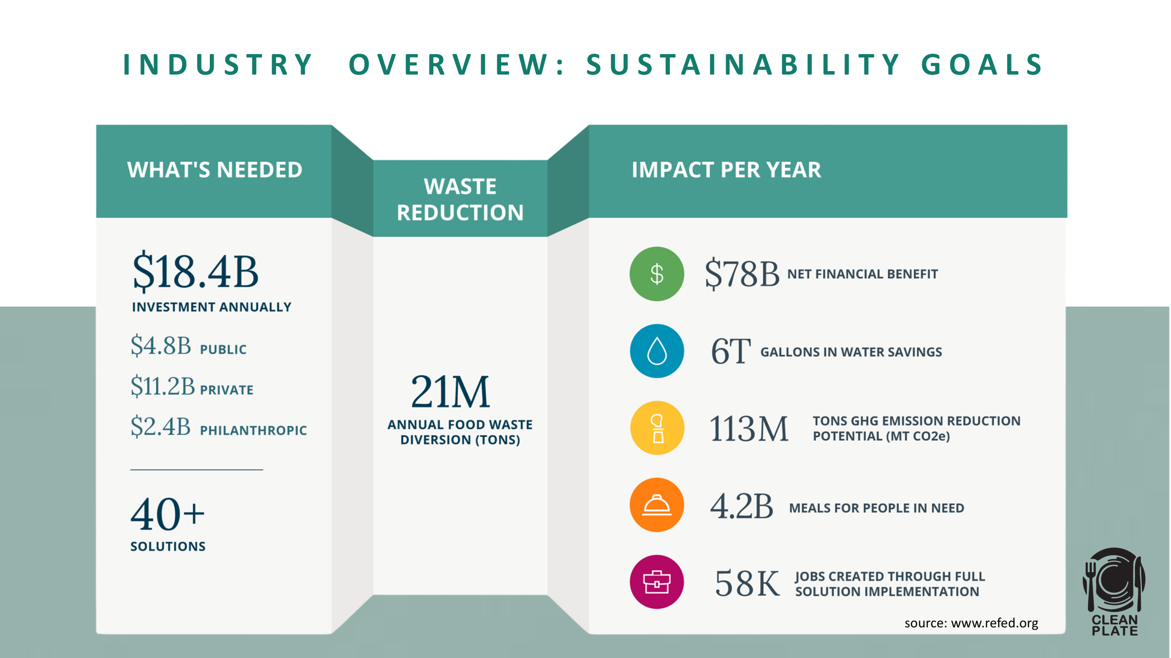

Slide 9
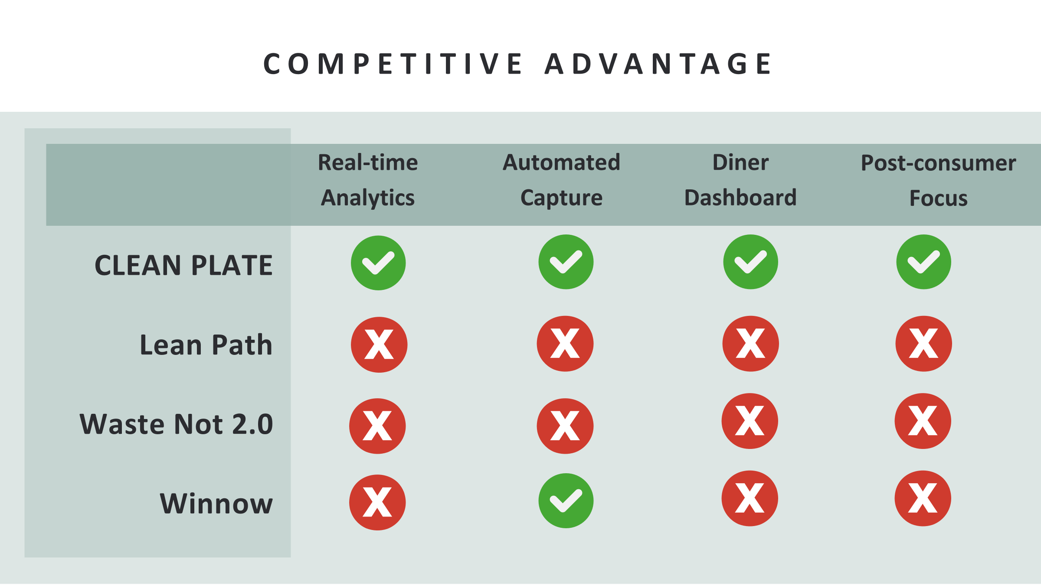
Real Time Analytics
Automated Capture
Diner Dashboard
Plate Waste Focus

Slide 11
